Slide 1


A Mozambican/UK-based charity aiming for love and dignity
. . . what Father accepts as pure and faultless is this: to look after orphans and widows in their distress . . .

Slide 2
Focus
Poverty & relief
Assisting the exploited ones
Education & training
Micro-enterprise
Widening faith and connecting
Advocating and funding vision

Slide 3
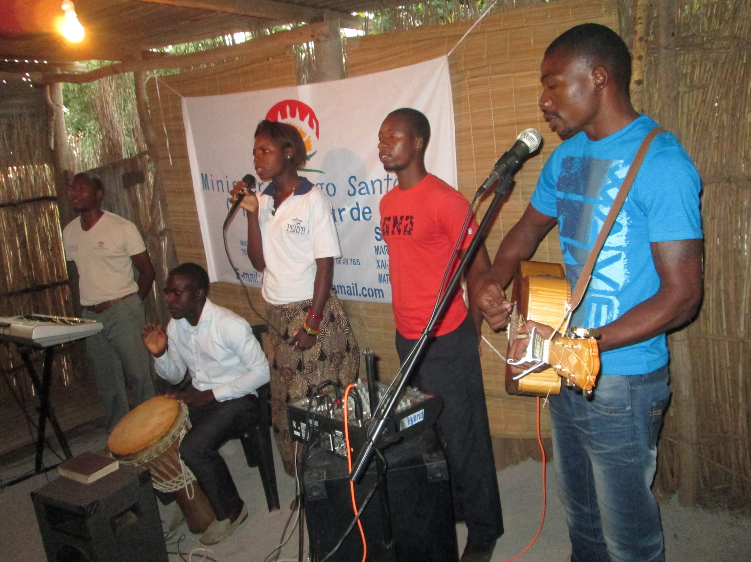
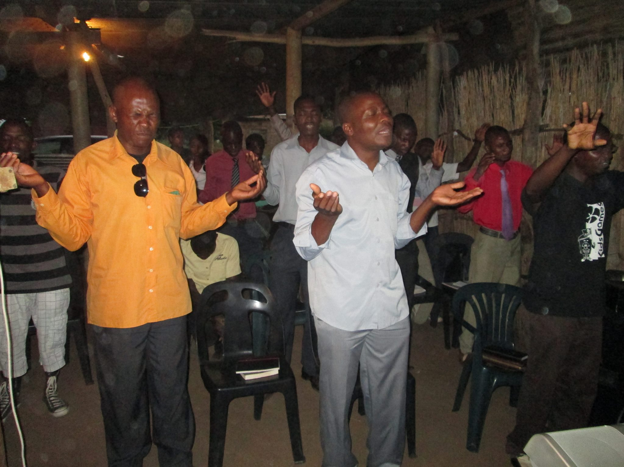
Passion

Slide 4
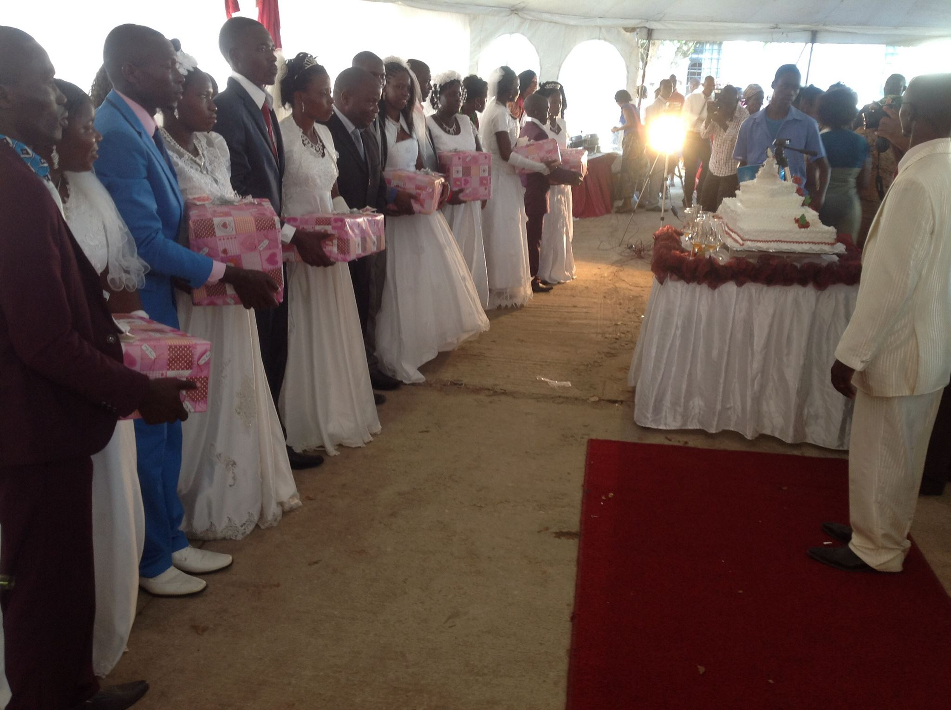
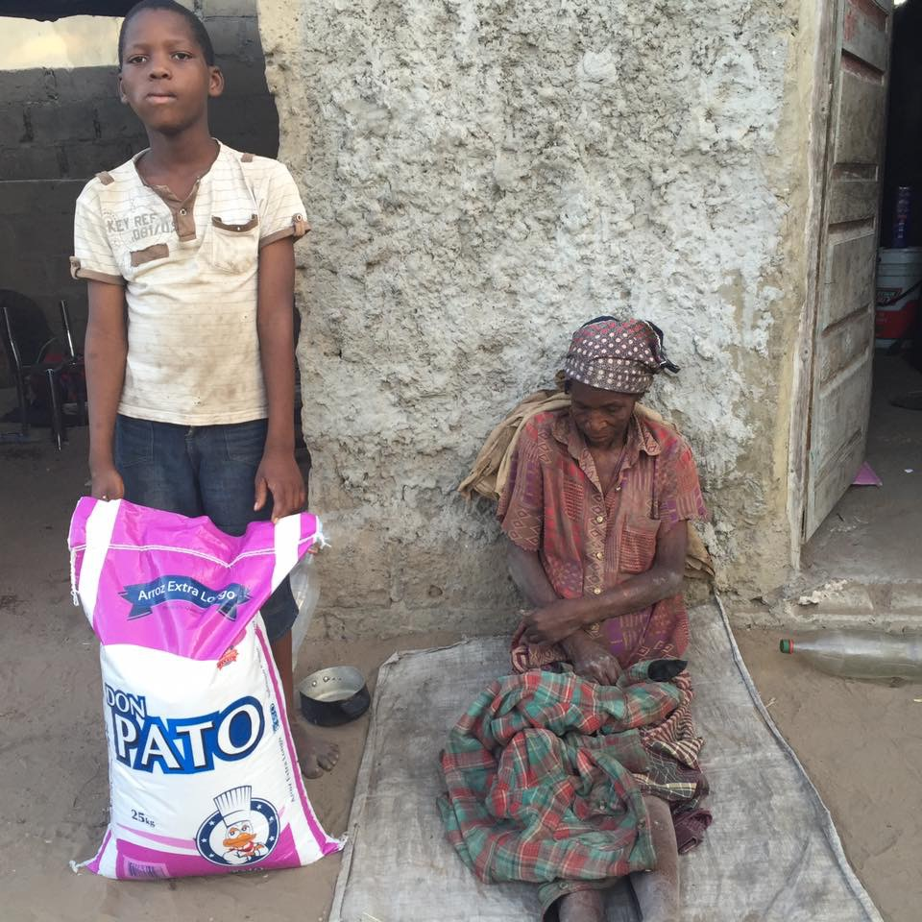
Standing with the most vulnerable

Slide 5
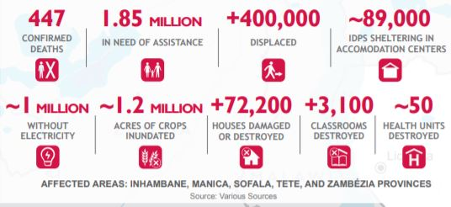
Loving and providing practical support to local leaders, communities, children and orphans in:
Chimoio, Catandica and Nhapassa.

Slide 6
Conditions
Vast destruction of land and housing
Families sharing same shelter
Loss of basic goods and clothing
Outbreak of tropical diseases
Grief and desperation
Challenge of rebuilding with scarce resources

Slide 7
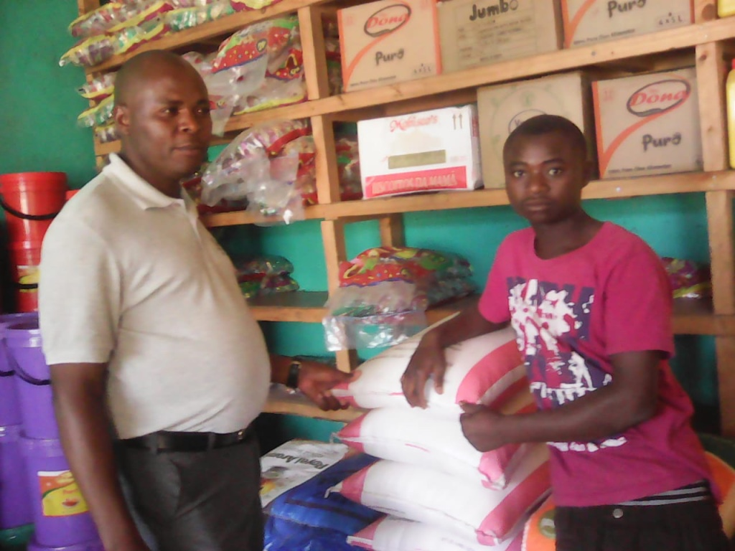
Relief & Rebuilding

Slide 8
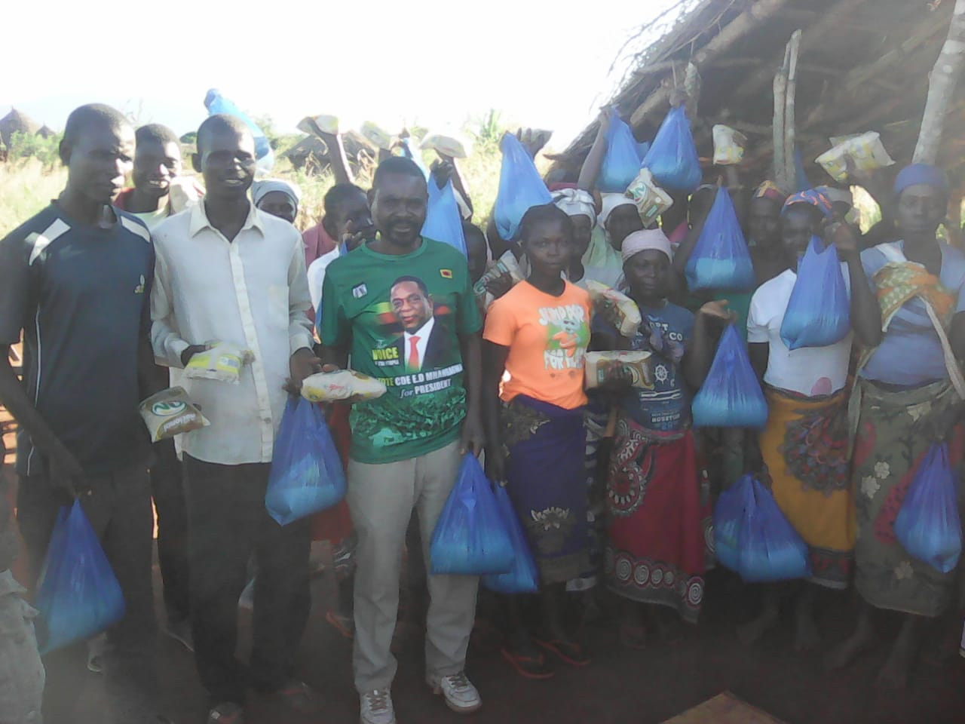
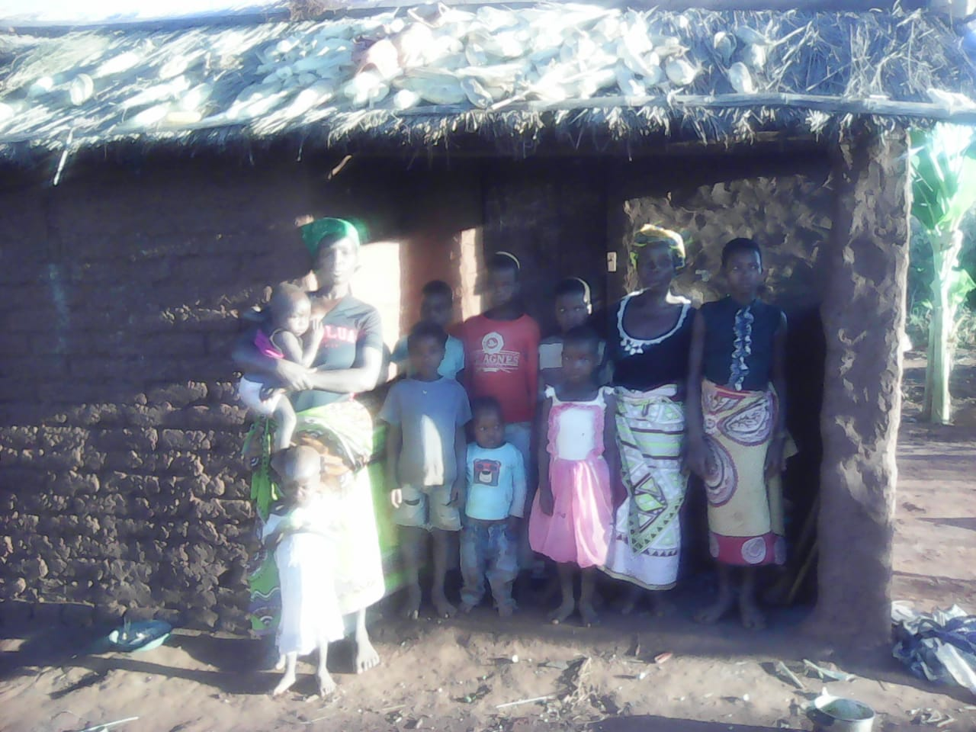
Feeding the hungry

Slide 9
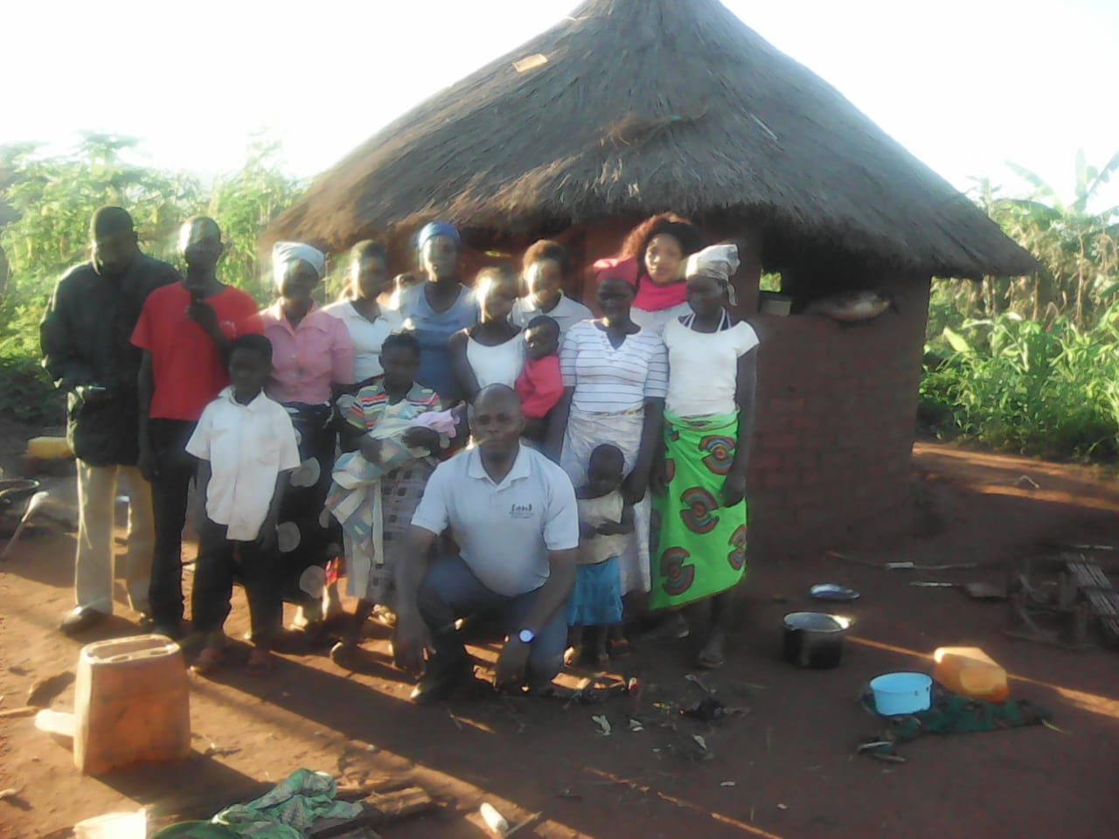
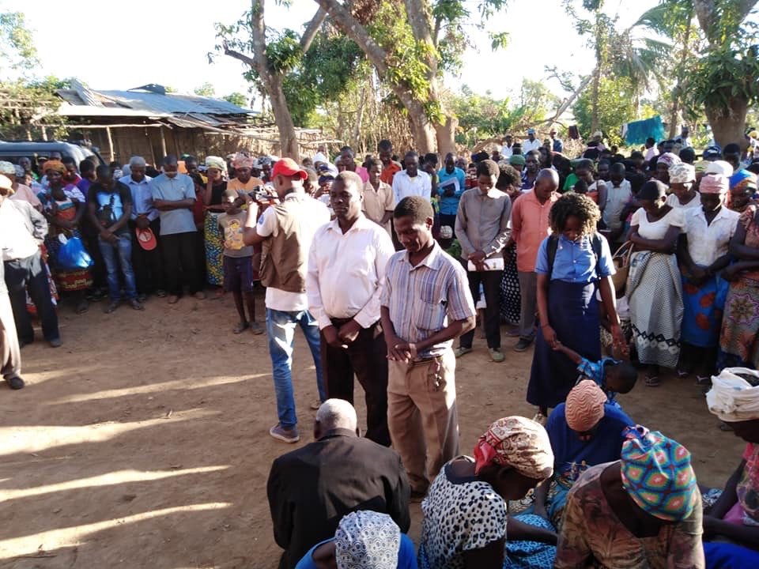
Loving through pastoral care

Slide 10
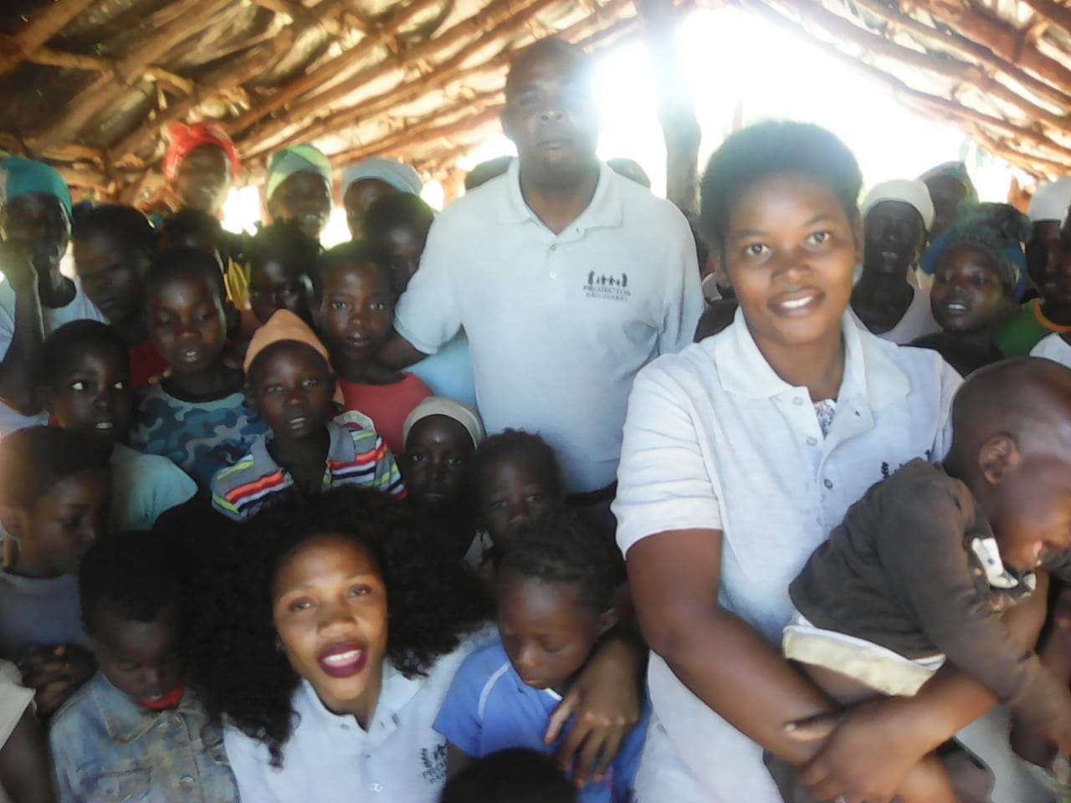
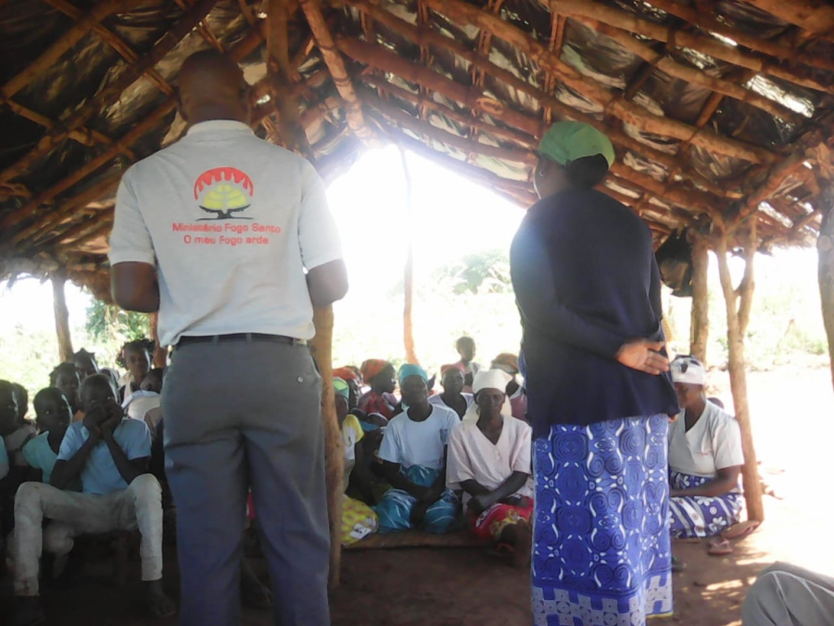
Encouraging the church

Slide 11
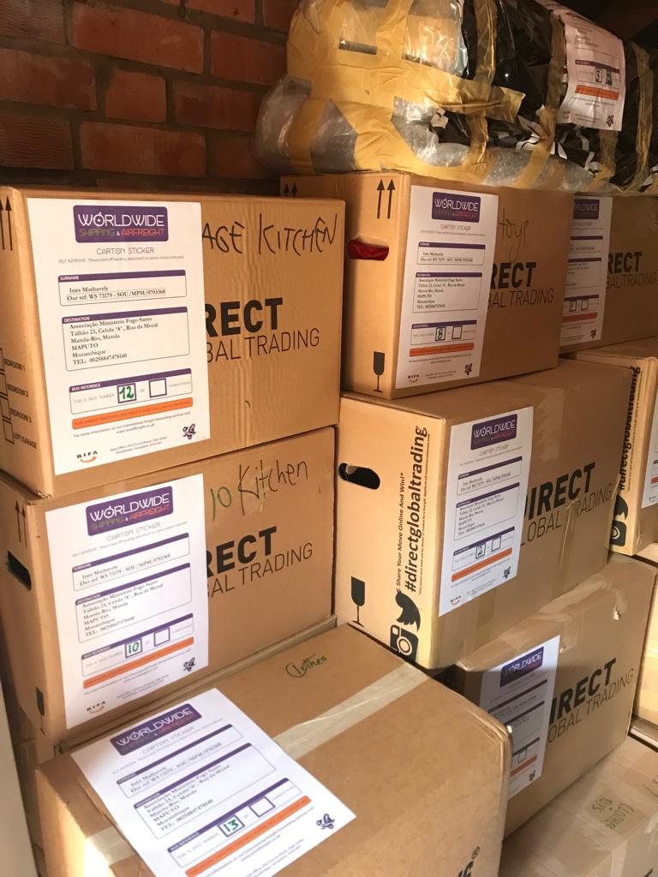
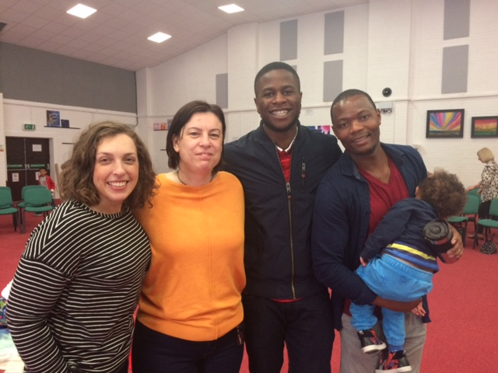
Breaking cycles of poverty

Slide 12
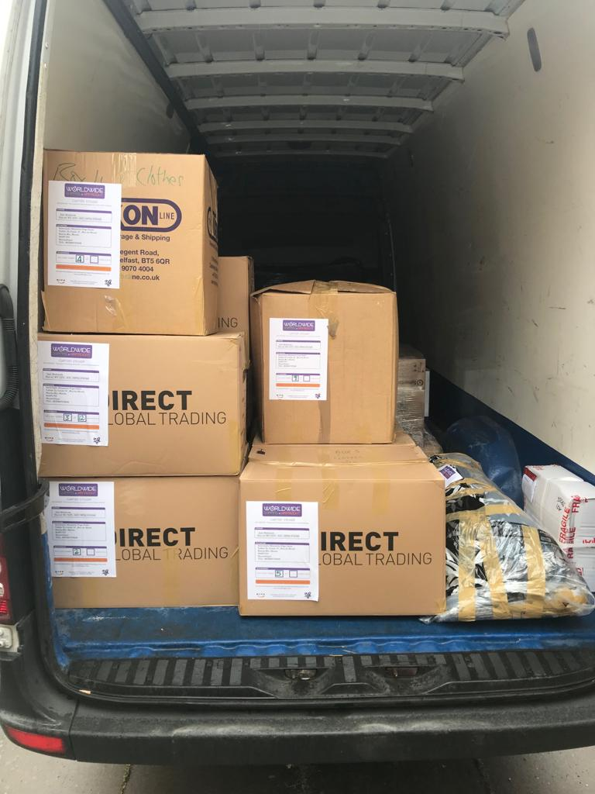
Providing resources & building hope
Sewing machines
Musical instruments
Clothing
Toys
Educational tools

